Slide 1
Describing Data:
Displaying and Exploring Data
4

Slide 2
GOALS
Develop and interpret a dot plot.
Develop and interpret a stem-and-leaf display.
Compute and understand quartiles, deciles, and percentiles.
Construct and interpret box plots.
Compute and understand the coefficient of skewness.
Draw and interpret a scatter diagram.
Construct and interpret a contingency table.

Slide 3
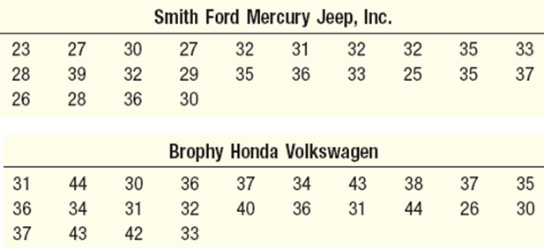
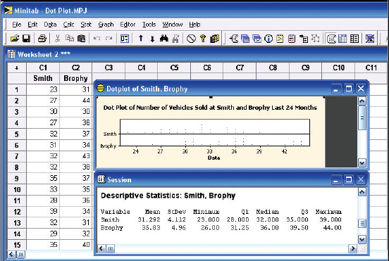
Dot Plots
A dot plot groups the data as little as possible and the identity of an individual observation is not lost.
To develop a dot plot, each observation is simply displayed as a dot along a horizontal number line indicating the possible values of the data.
If there are identical observations or the observations are too close to be shown individually, the dots are “piled” on top of each other.
EXAMPLE
Reported below are the number of vehicles sold in the last 24 months at Smith Ford Mercury Jeep, Inc., in Kane, Pennsylvania, and Brophy Honda Volkswagen in Greenville, Ohio. Construct dot plots and report summary statistics for the two small-town Auto USA lots.

Slide 4
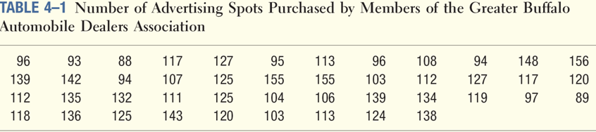
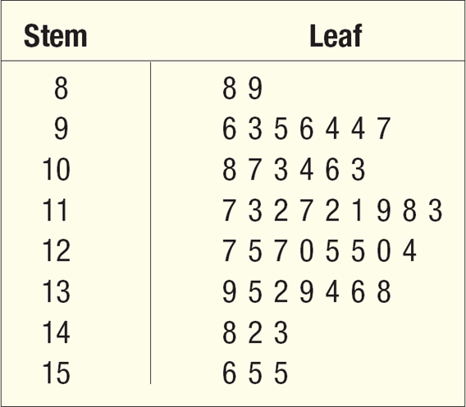
Stem-and-Leaf
Stem-and-leaf display is a statistical technique to present a set of data. Each numerical value is divided into two parts. The leading digit(s) becomes the stem and the trailing digit the leaf. The stems are located along the vertical axis, and the leaf values are stacked against each other along the horizontal axis.
Two disadvantages to organizing the data into a frequency distribution:
  The exact identity of each value is lost
  Difficult to tell how the values within each class are distributed.
EXAMPLE
Listed in Table 4–1 is the number of 30-second radio advertising spots purchased by each of the 45 members of the Greater Buffalo Automobile Dealers Association last year. Organize the data into a stem-and-leaf display. Around what values do the number of advertising spots tend to cluster? What is the fewest number of spots purchased by a dealer? The largest number purchased?

Slide 5
Quartiles, Deciles and Percentiles
The standard deviation is the most widely used measure of dispersion.
Alternative ways of describing spread of data include determining the location of values that divide a set of observations into equal parts.
These measures include quartiles, deciles, and percentiles.
To formalize the computational procedure, let L_{p} refer to the location of a desired percentile. So if we wanted to find the 33rd percentile we would use L₃₃ and if we wanted the median, the 50th percentile, then L₅₀.
The number of observations is n, so if we want to locate the median, its position is at (n + 1)/2, or we could write this as (n + 1)(P/100), where P is the desired percentile

Slide 6
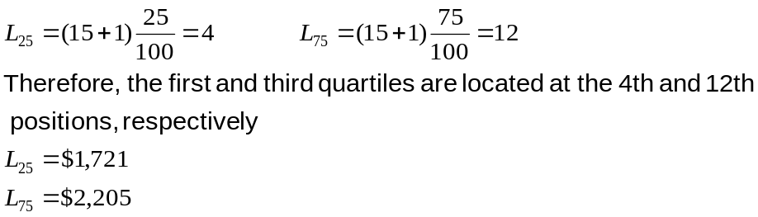
Percentiles - Example
EXAMPLE
Listed below are the commissions earned last month by a sample of 15 brokers at Salomon Smith Barney’s Oakland, California, office.
$2,038 $1,758 $1,721 $1,637 $2,097 $2,047 $2,205 $1,787 $2,287 $1,940 $2,311 $2,054 $2,406 $1,471 $1,460
Locate the median, the first quartile, and the third quartile for the commissions earned.
Step 1: Organize the data from lowest to largest value
$1,460 $1,471 $1,637 $1,721 $1,758 $1,787 $1,940 $2,038 $2,047 $2,054 $2,097 $2,205 $2,287 $2,311 $2,406
Step 2: Compute the first and third quartiles. Locate L₂₅ and L₇₅ using:

Slide 7
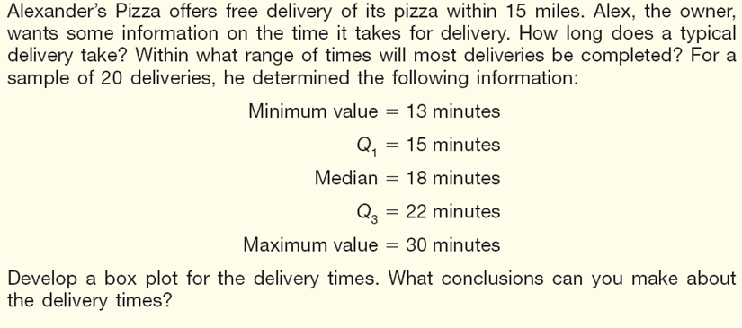
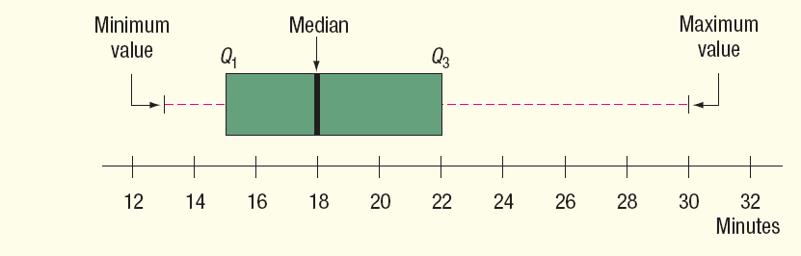
Boxplot - Example
Step1: Create an appropriate scale along the horizontal axis.
Step 2: Draw a box that starts at Q1 (15 minutes) and ends at Q3 (22
minutes). Inside the box we place a vertical line to represent the median (18 minutes).
Step 3: Extend horizontal lines from the box out to the minimum value (13
minutes) and the maximum value (30 minutes).

Slide 8
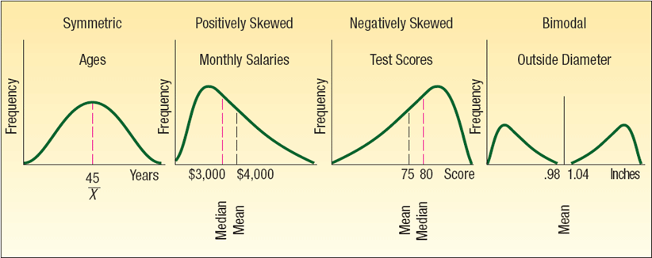
Skewness
Another characteristic of a set of data is the shape.
There are four shapes commonly observed: symmetric, positively skewed, negatively skewed, bimodal.
The coefficient of skewness can range from -3 up to 3.
  A value near -3, indicates considerable negative skewness.
  A value such as 1.63 indicates moderate positive skewness.
  A value of 0, which will occur when the mean and median are equal, indicates the distribution is symmetrical and that there is no skewness present.

Slide 9

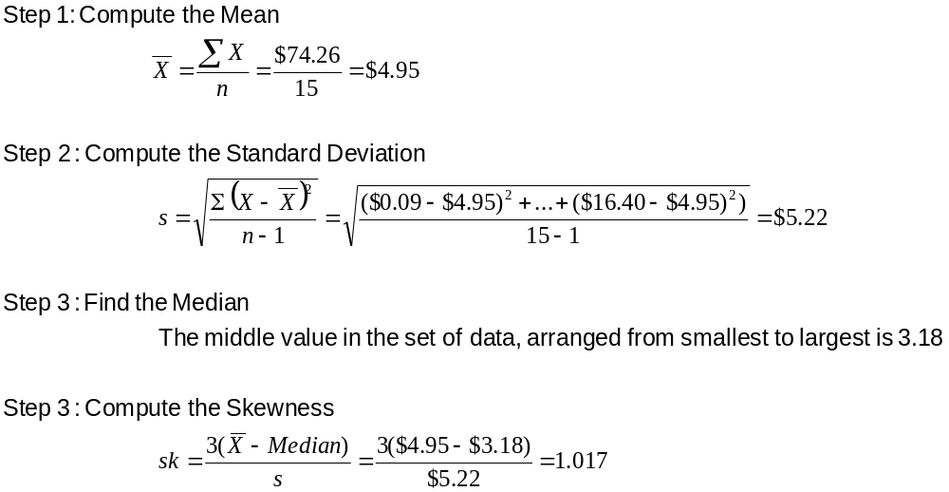
Skewness – An Example
EXAMPLE
Following are the earnings per share for a sample of 15 software companies for the year 2007. The earnings per share are arranged from smallest to largest.
Compute the mean, median, and standard deviation. Find the coefficient of skewness using Pearson’s estimate. What is your conclusion regarding the shape of the distribution?

Slide 10
Describing Relationship between Two Variables
When we study the relationship between two variables we refer to the data as bivariate.
One graphical technique we use to show the relationship between variables is called a scatter diagram.
To draw a scatter diagram we need two variables. We scale one variable along the horizontal axis (X-axis) of a graph and the other variable along the vertical axis (Y-axis).

Slide 11
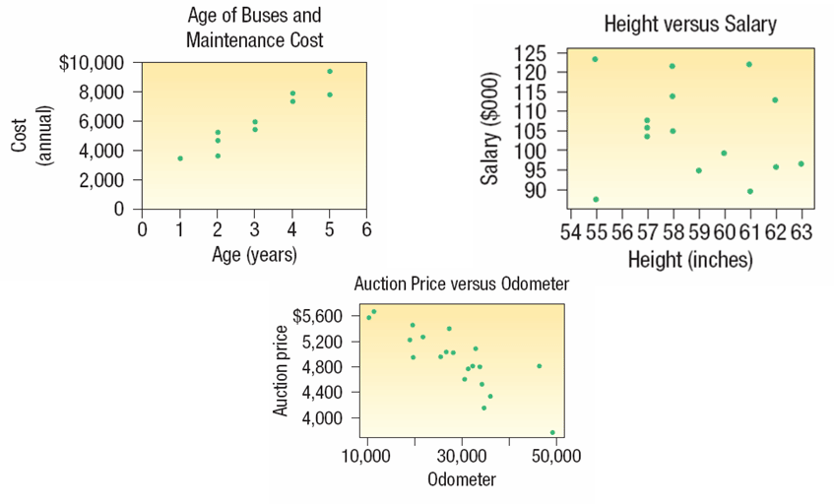
Describing Relationship between Two Variables – Scatter Diagram Examples

Slide 12
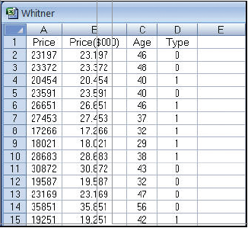
Describing Relationship between Two Variables – Scatter Diagram Excel Example
In Chapter 2 data from AutoUSA was presented. In this case the information concerned the prices of 80 vehicles sold last month at the Whitner Autoplex lot in Raytown, Missouri. The data shown include the selling price of the vehicle as well as the age of the purchaser.
Is there a relationship between the selling price of a vehicle and the age of the purchaser?
Would it be reasonable to conclude that the more expensive vehicles are purchased by older buyers?

Slide 13
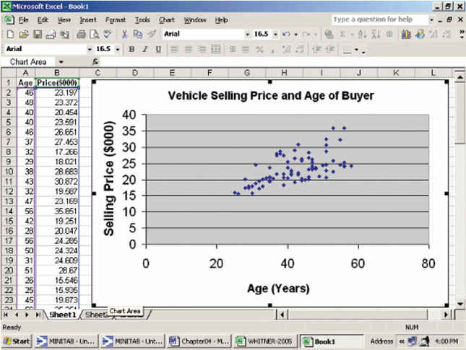
Describing Relationship between Two Variables – Scatter Diagram Excel Example

Slide 14
Contingency Tables
A scatter diagram requires that both of the variables be at least interval scale.
What if we wish to study the relationship between two variables when one or both are nominal or ordinal scale? In this case we tally the results in a contingency table.
Examples:
Students at a university are classified by gender and class rank.
A product is classified as acceptable or unacceptable and by the shift (day, afternoon, or night) on which it is manufactured.
A voter in a school bond referendum is classified as to party affiliation (Democrat, Republican, other) and the number of children that voter has attending school in the district (0, 1, 2, etc.).

Slide 15
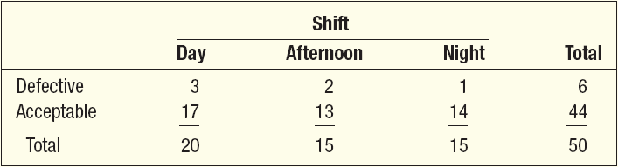
Contingency Tables – An Example
A manufacturer of preassembled windows produced 50 windows yesterday. This morning the quality assurance inspector reviewed each window for all quality aspects. Each was classified as acceptable or unacceptable and by the shift on which it was produced. Thus we reported two variables on a single item. The two variables are shift and quality. The results are reported in the following table.
Using the contingency table able, the quality of the three shifts can be compared. For example:
On the day shift, 3 out of 20 windows or 15 percent are defective.
On the afternoon shift, 2 of 15 or 13 percent are defective and
On the night shift 1 out of 15 or 7 percent are defective.
Overall 12 percent of the windows are defective

